Slide 1
SQL AND TABLEAU PORTFOLIO PROJECT
Problem Statement
Dashboard 1: Summary
1.Total loan application:
We need to calculate the total number of loan applications received during a specified period additionally ,it is essential
to monitor the Month-to-date(MTD) loan applications and track changes month-over-month(MOM).
2.Total funded amount:
Understanding the total amount of fund disbursed as loan is crucial .we also want to keep an eye on the MTD Total funded amount and analyse the
Month-over-Month changes in this metric
3.Total amount Received:
We should analyse the Month-to-date(MTD) total amount received and month-over-month(MOM)changes
4.Average Interest Rate:
Calculating the average interest rate across all loans, MTD, and monitoring the Month-over-month(MOM) variations in interest rate.
5.Average Debt-to-income ratio(DTI):
We need to calculate the average DTI for all loans, MTD and track Month-over-Month(MOM)function.

Slide 2
Good loan vs Bad loan KPI’s
Good loan: Bad loan:
1.Good loan application Percentage 1.Bad loan application Percentage
2.Good loan application 2.Bad loan application
3.Good loan funded amount 3.Bad loan funded amount
4.Good loan total received amount 4.Bad loan total received amount
Loan status Grid View:
In order to gain a comprehensive overview of our lending operations and monitor the performance of loans , we aim to create a grid view report categorized by “loan status ”.By providing insights into metrics such as “Total loan applications”, ”Total funded amount”, “Total amount Received”
“Month-to-date funded amount” ,”MTD amount received”, “Average interest rate”, and “Average DTI rate”,. This grid view will empower us to make data driven decisions and assess the health of our loan portfolio.

Slide 3
Dashboard 2: Overview
CHARTS:
1.Monthly trends by issue date(Line chart):
To identify seasonality and long term trends in lending activities.
2.Regional analysis by state(Filled map):
To identify the regionals with significant lending activity and assess regional disparities.
3.Loan term analysis(Donut chart):
To allow the client to understand the distribution of loan across various term length.
4.Employee length analysis(Bar Chart):
How lending metrics are distributed among borrowers with a different employment length , helping us access the impact of employment
history on loan application
5.Loan Purpose breakdown(Bar chart):
Will provide a visual breakdown of loan metrics based on the stated purpose of loan , aiding in the understanding of the primary reasons
borrowers seek financing
6.Home ownership analysis( Tree Map):
For a hierarchical view of how home ownership impacts loan application and disbursements.

Slide 4
Dashboard 3: Details
GRID:
Need for a Comprehensive ‘Details Dashboard” that provides a consolidated view of all the essential
Information within our loan data. This Details dashboard aims to offer a holistic snapshot of key loan related metrics and data points , enabling uses to access critical information efficiently.

Slide 5
Functionalities we will learn
SQL-MS SQL SERVER
Creating Database
Creating Table
Select
Date name
Date part
Cast
Decimal
Month
Hour
Quarter
Day
Group by
Order by
Limit
Count
Distinct
CTE
Partition
Tableau
Connecting to SQL server
Data Cleaning
Data Modelling
Data Processing
Power Query
Data Tables
Time Intelligence function
DAX
Date function
Text function
Filter Function
Calculate
SUM/SUMX
Creating KPI
New card visual
Creating Charts
Formatting visuals
Creating functions
Navigation

Slide 6
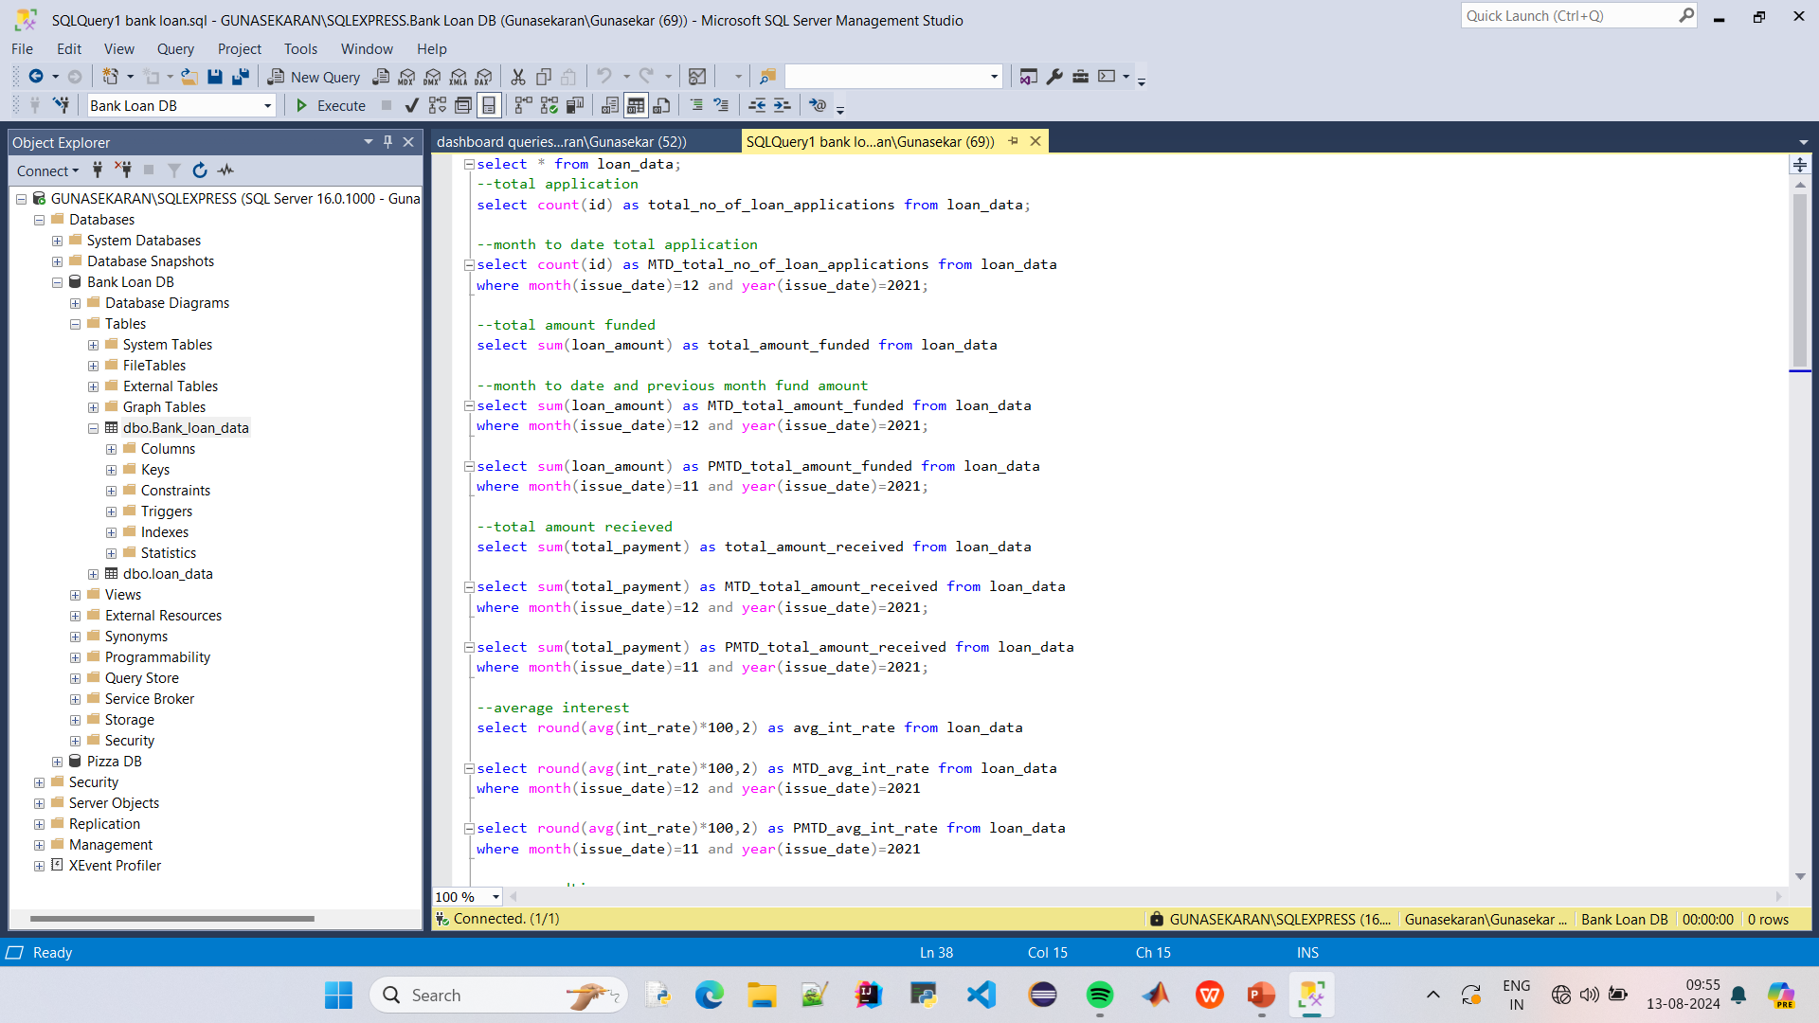
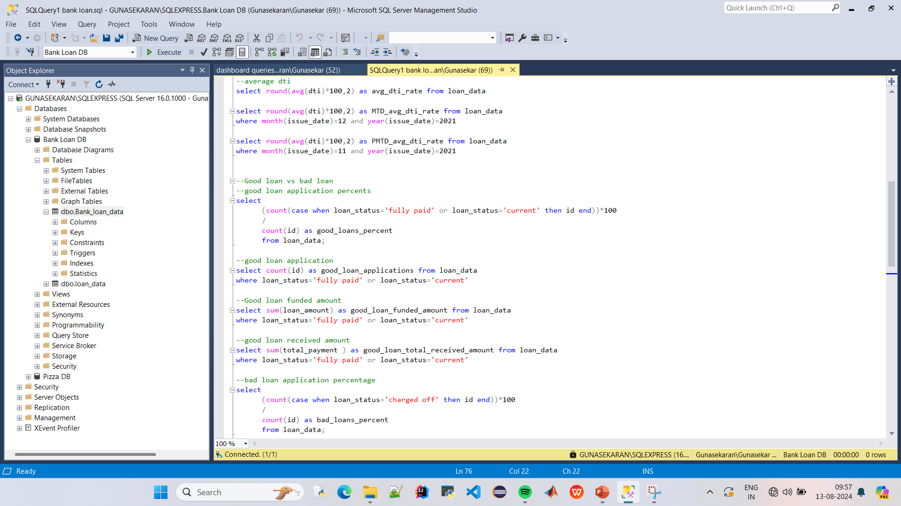
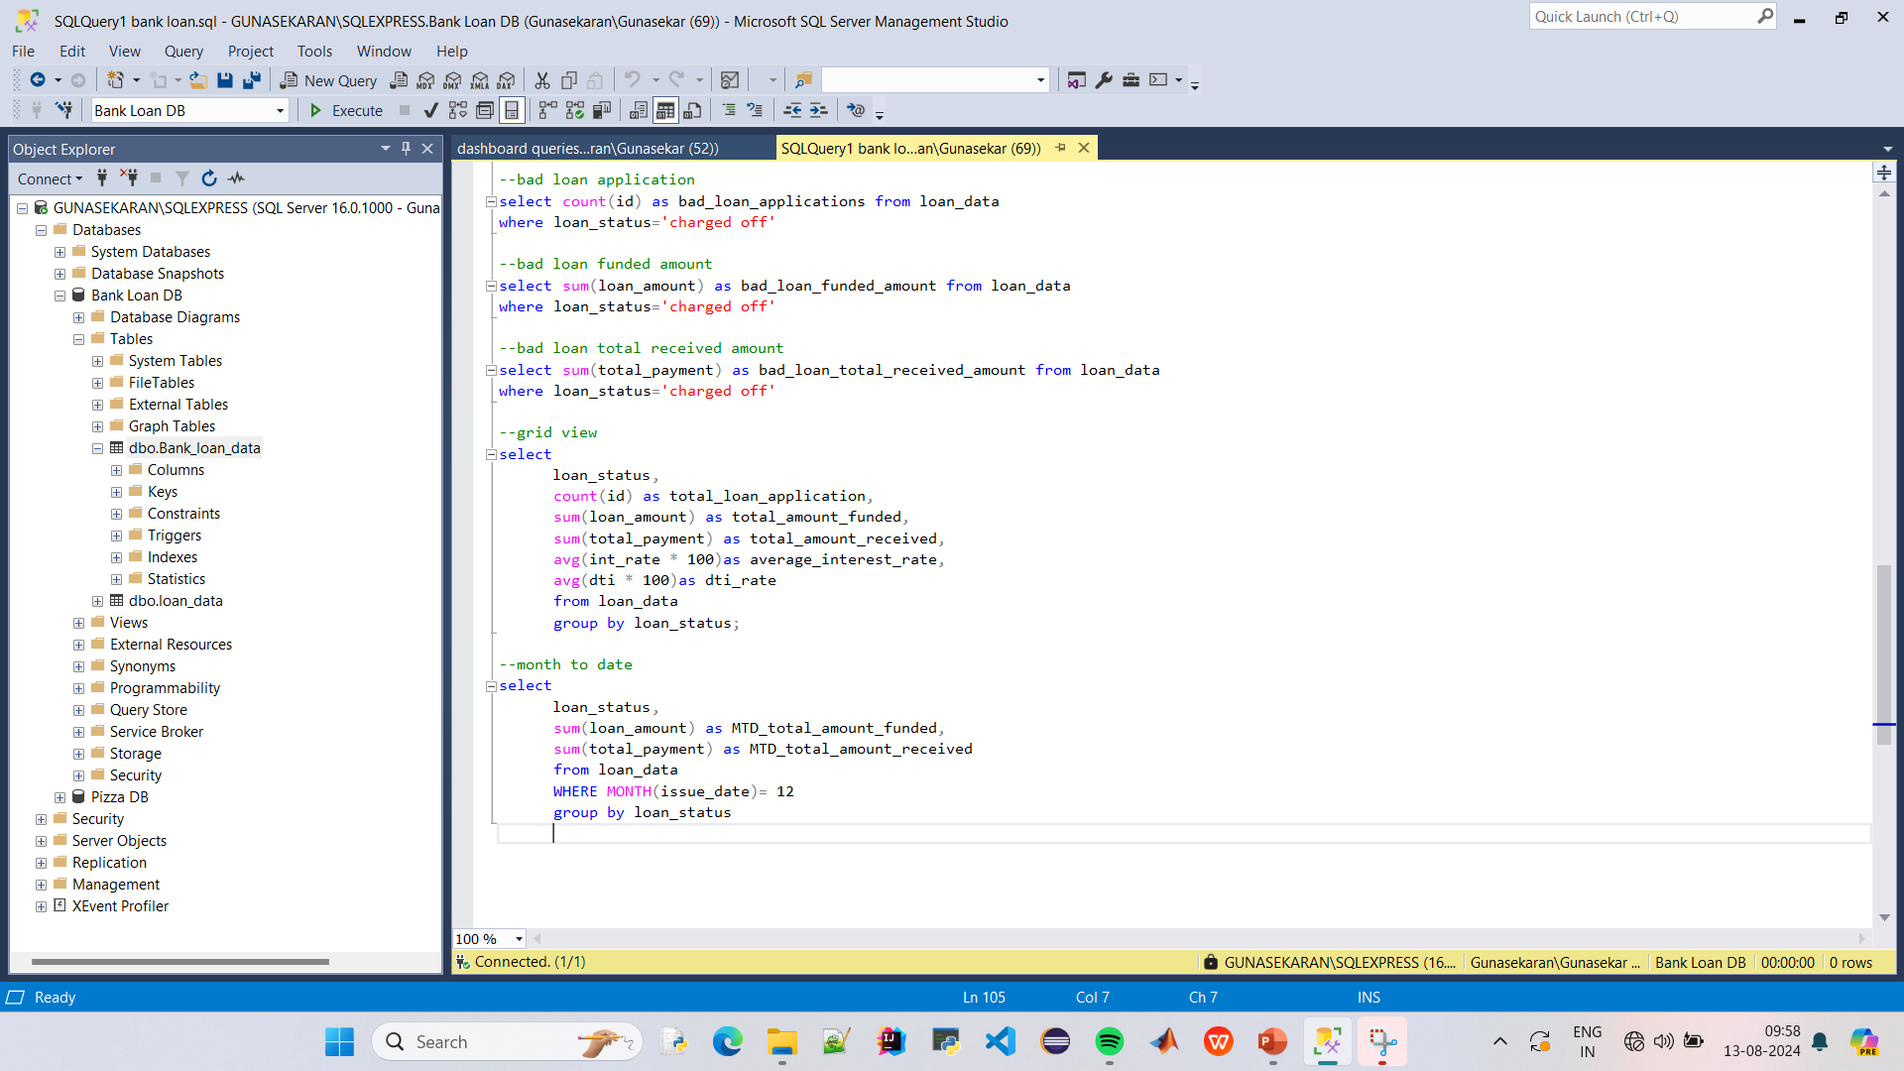
Dashboard 1 Queries:

Slide 7
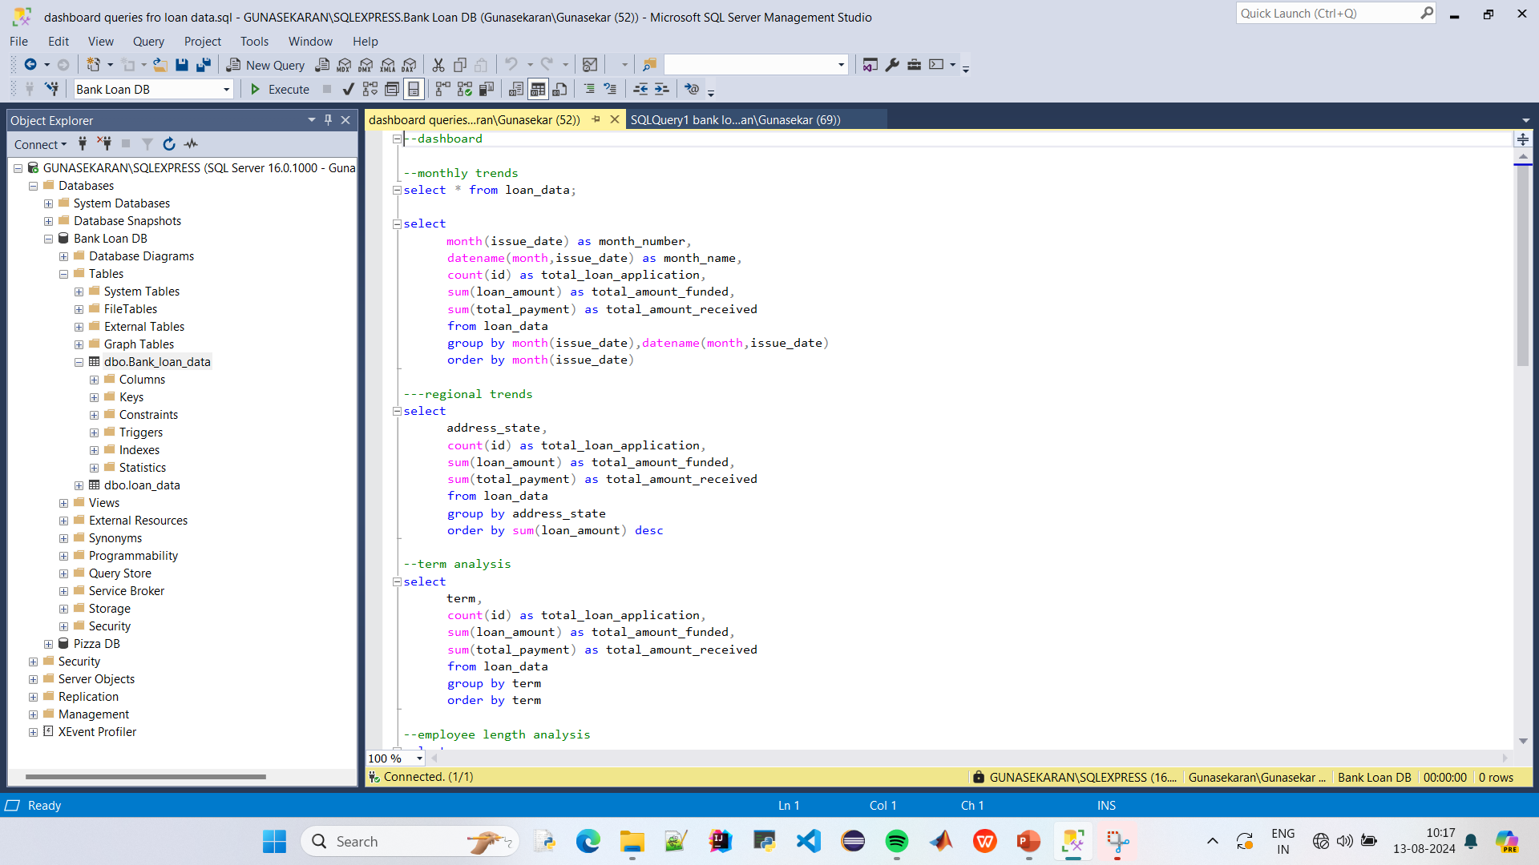
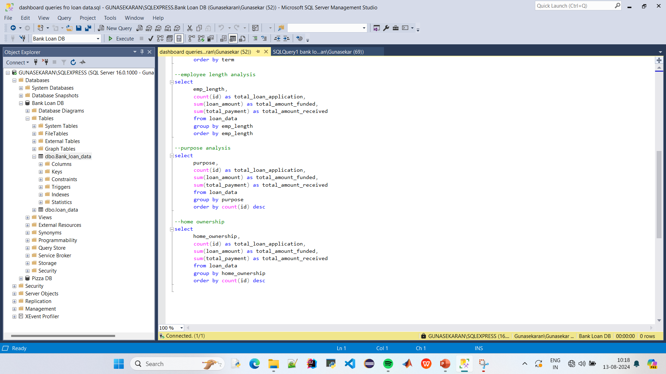
Dashboard 2 Queries:

Slide 8
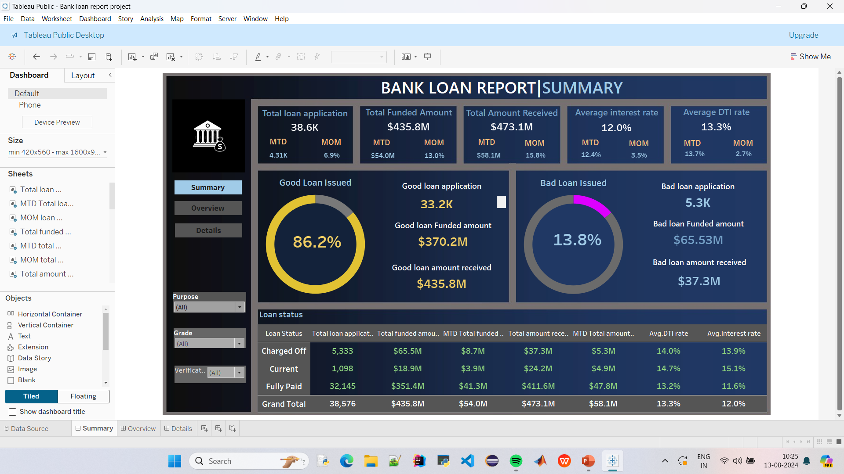

Slide 9
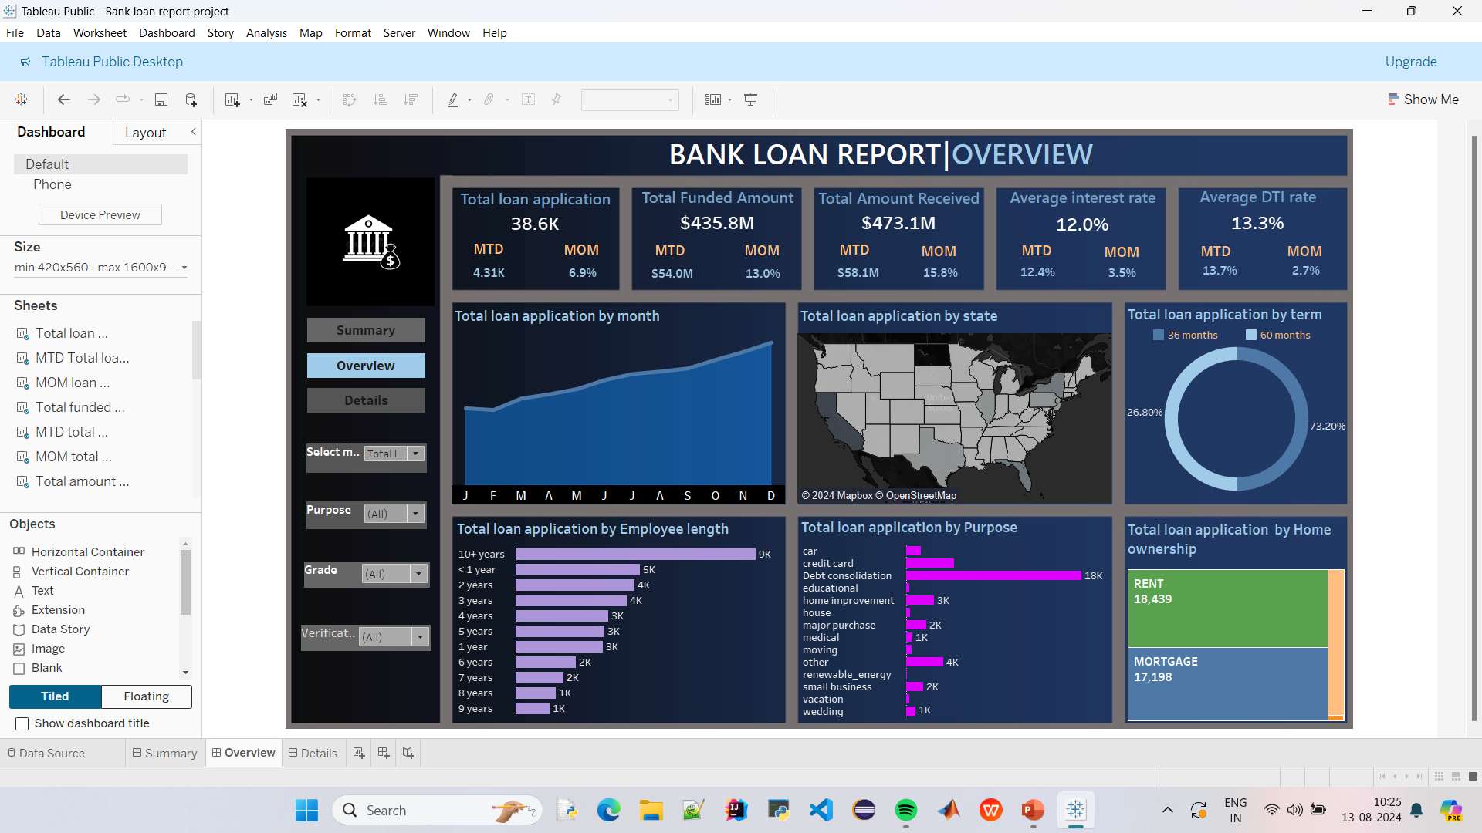

Slide 10
